Slide 1
RL Datix: Be Safe Events Orientation for Managers & Medical Directors

Slide 2
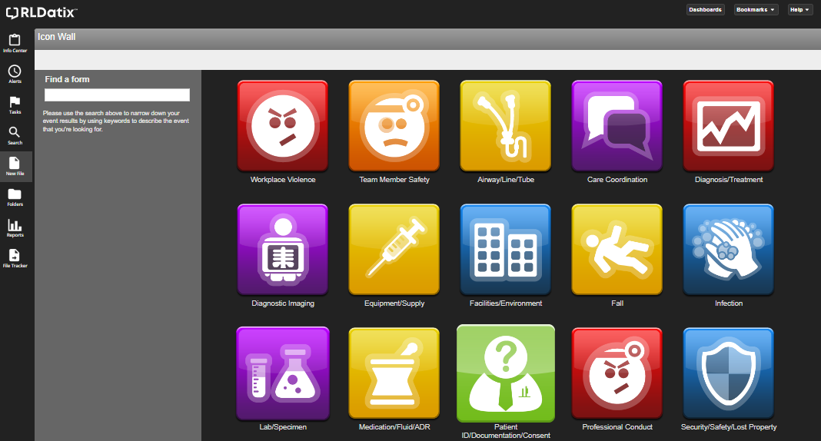
Login Screen: New File

Slide 3
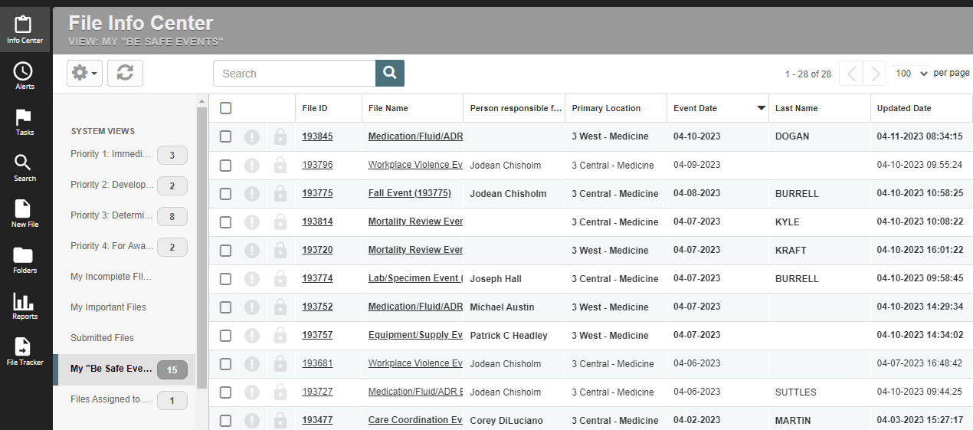
Info Center: My Be Safe Events

Slide 4
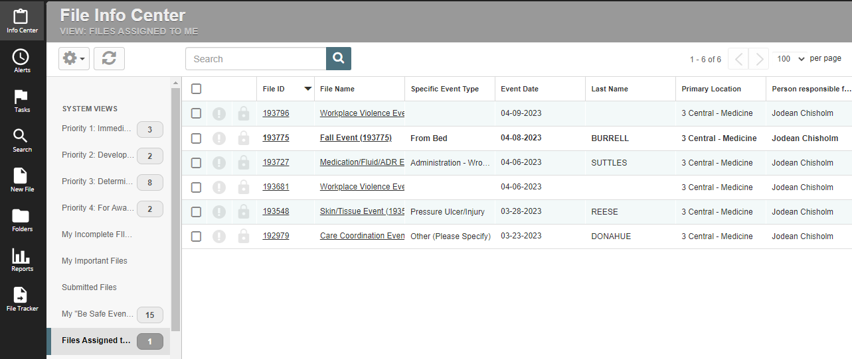
Info Center: Files Assigned to Me

Slide 5
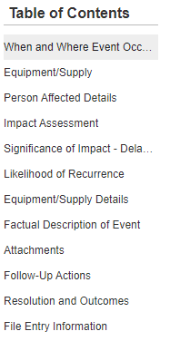
Navigating: Table of Contents
NEXT

Slide 6
Primary Location
NEXT

Slide 7
Other Service/Location Involved
NEXT

Slide 8
Tasking

Slide 9
Tasks: All Tasks

Slide 10
Tasks: New Task

Slide 11
Add/Modify Task
NEXT

Slide 12
Task: Required Fields

Slide 13
Tasks: Completing a Task

Slide 14
Complete Task

Slide 15
Impact Assessment
NEXT

Slide 16
Factual Description of Event
NEXT

Slide 17
Resolutions and Outcomes
NEXT

Slide 18
Resolutions and Outcomes
From a patient safety standpoint, the most effective to least effective strategies for mitigating risk are
Fail Safes and Constraints
Forcing Functions
Automation and Computerization
Standardization
Redundancies
Reminders and Checklists
Rules and Policies
Education and Information
Suggestions to be more careful
We would much rather focus on strategies at the top of this list.
NEXT

Slide 19
Resolutions and Outcomes
NEXT

Slide 20
Search

Slide 21
Search: More Options
NEXT

Slide 22
Search:

Slide 23
Search Results
NEXT

Slide 24
Reports

Slide 25
Report Manager Admin Picks

Slide 26
Count by General Event Type

Slide 27
Reports: Change Parameters

Slide 28
Reports: Updated Parameters
NEXT

Slide 29
Favorites

Slide 30
Search All Reports

Slide 31
Search Results
NEXT

Slide 32
Be Safe Events Website

Slide 33
Be Safe Events Website

Slide 34
Manager & Medical Director Review of Be Safe Events
NEXT

Slide 35
Be Safe Events Website
https://besafe.uvahs.org/manager-medical-director-review-of-be-safe-events/
Patient Safety Officers
Bizz Glover | Heidi Ross | Mary Jane Willis | Shelly Miller
Equipment/ Supplies | Diagnosis/ Treatment | Airway/Line/Tube | Infection
Facilities/ Environment | Diagnostic Imaging | Care Coordination | Security/Safety
Good Catch | Medication/Fluid | Lab/Specimen | Workplace Violence
Visitor Falls | Professional Conduct | Patient Falls
 | Surgery Procedure | Pt ID/Consent/ Documentation
 | Transfusion/Blood | Skin/Tissue
NEXT

Slide 36
Post-Test
What are the two questions that must be answered by leadership in the Investigation Findings/Corrective Actions field?
Who is to blame and how will they be reprimanded?
Why did this happen and how do we prevent it from happening again?
Who needs to be pulled into the conversation and what is the resolution?
Has this Be Safe Event been reviewed and by whom?

